Slide 1
Crayons to Careers (C2C)
Helping young learners explore careers in STEM, including areas such as manufacturing, automation, and engineering, allows them to discover potential future careers and understand how they can positively contribute to society.

Slide 2
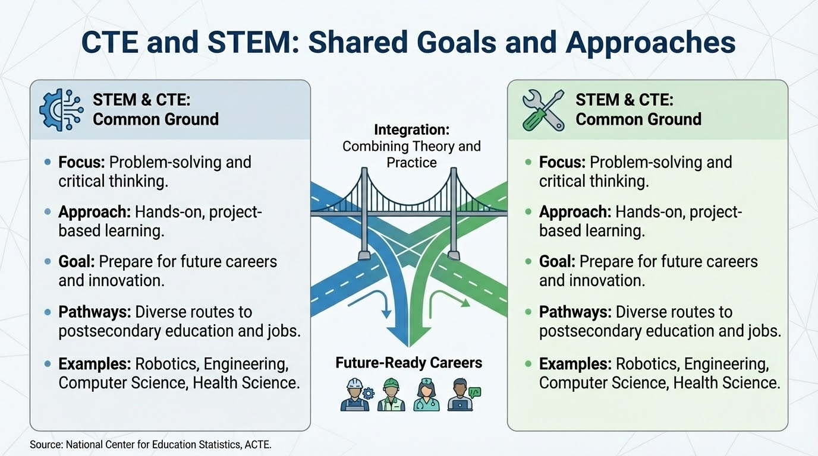

Slide 3
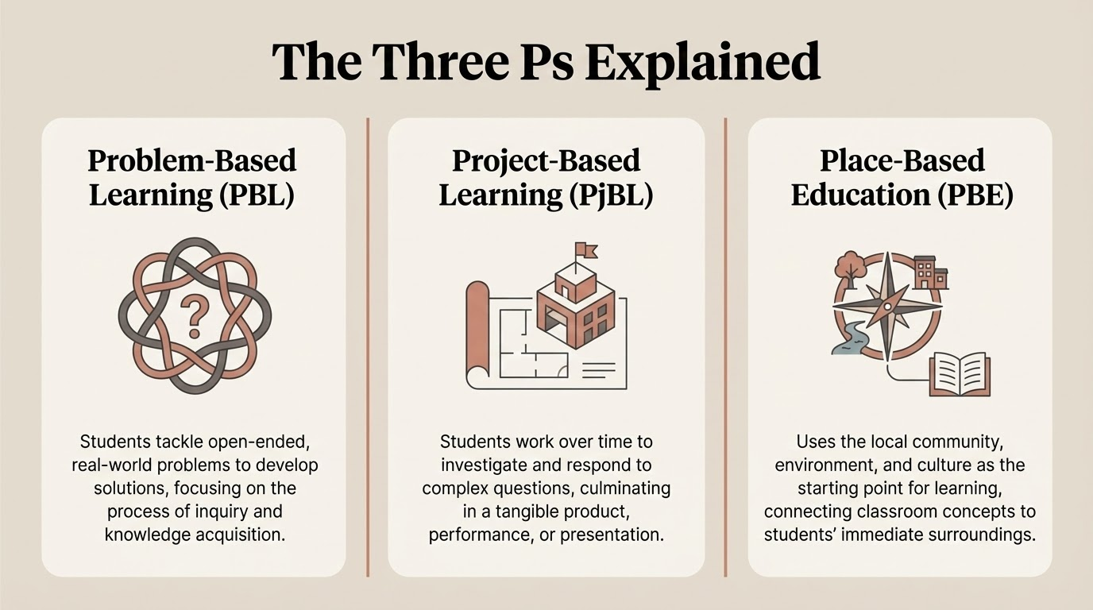

Slide 4
Crayons to Careers (C2C)
Objectives
Career Development Support: Crayons to Careers (C2C) aims to support career development activities in schools, utilizing Youth Solutions and community partners to help implement the State of Michigan's K-12 Career Development Model, with a focus on ensuring equitable access for all students, including those from marginalized communities.
Early STEM and Career Awareness: C2C seeks to introduce elementary students to various career options and dispel misconceptions about STEM fields through engaging activities, interactive tours, and classroom visits. Special emphasis will be placed on reaching marginalized students to better prepare them for middle school and beyond.
Parent and Community Engagement: C2C will actively participate in Parent/Community Engagement Nights designed for parents of elementary students, fostering a supportive environment for children's early career exploration and ensuring inclusive participation from diverse communities.
Teacher Collaboration and Curriculum Integration: C2C will collaborate with teachers to integrate STEM career-related content into the curriculum, partnering with businesses and industries to provide hands-on learning experiences. These efforts will prioritize equity, ensuring marginalized students have equal opportunities to connect classroom lessons to real-world careers.

Slide 5
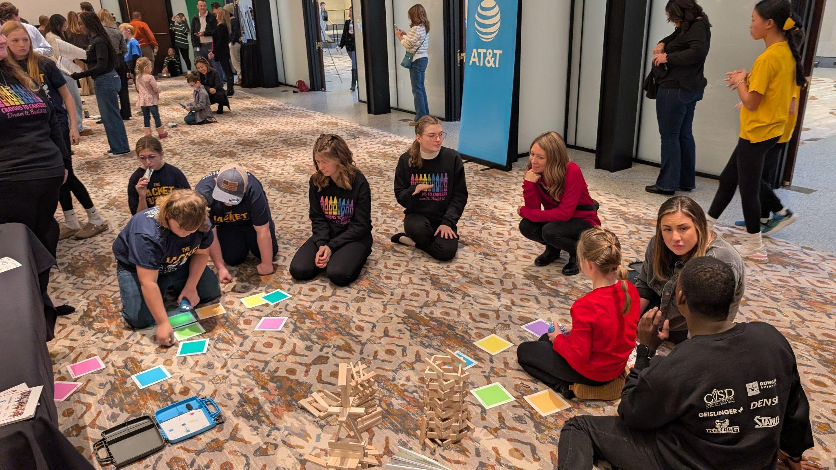
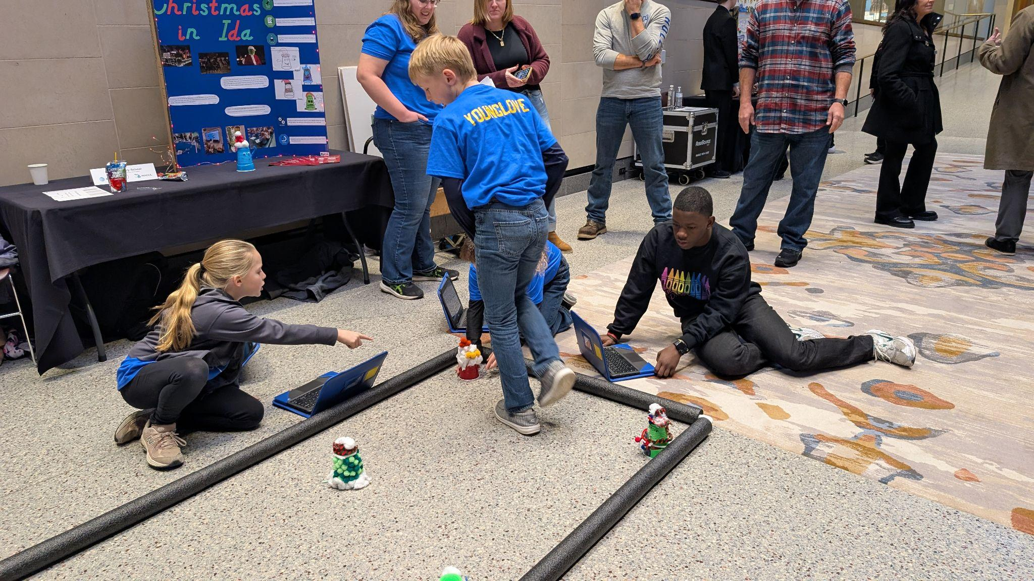
The Crayons to Careers (C2C) program fosters early STEM and career awareness in 3rd grade elementary students.
C2C's objectives include equitable career development support and community engagement efforts.
The project involves integrating STEM concepts and hands-on activities into the K-5 curriculum.
Strategies include partnering with local industries and providing teacher professional development.
Evidence-based programs are suggested to boost parental involvement in STEM education.

Slide 6
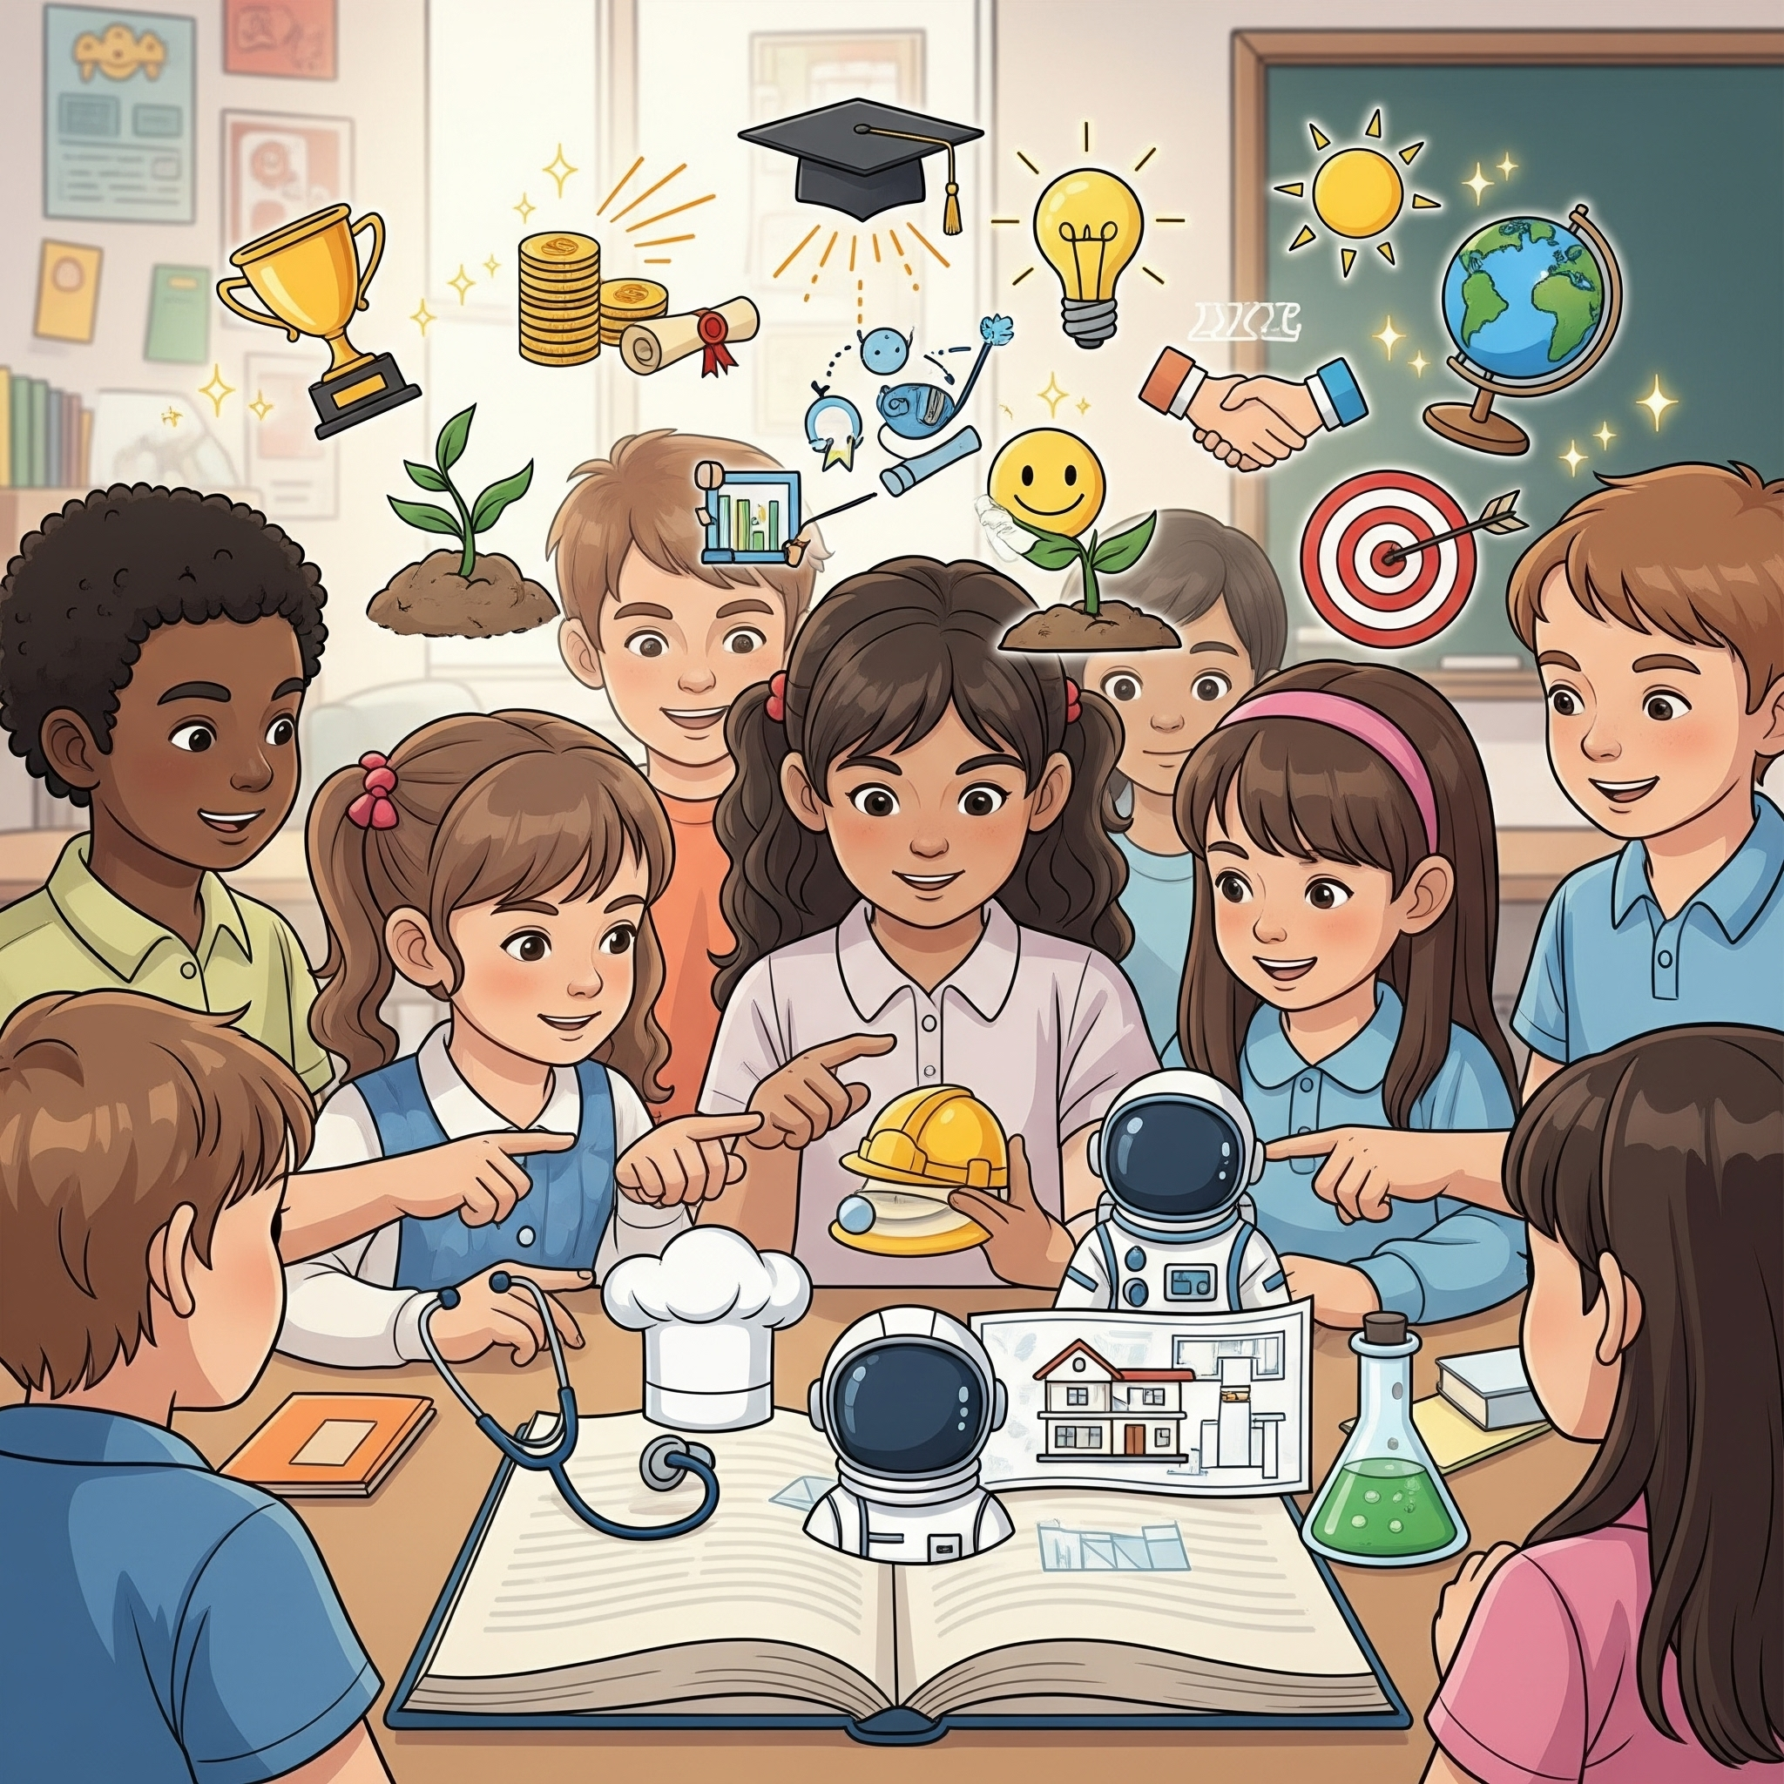
Metrics
Measured increase in elementary student career awareness.
Increased teacher capacity for integrating STEM content.
Documented growth in parent and community engagement.
Successful implementation of collaborative employer partnerships.

Slide 7
What we know-the baseline
Career Development is more that choosing a career from a menu of jobs and salaries.
Career development should follow child development (start early)
Educators and Employers should work collaboratively to deliver the message.
Teachers and employers have both a capacity and a skills gap-these partnerships take time and resources.

Slide 8
C2C - A Career Development Odessey
The Team:
Nikko Whitney-Education Academy Student and Team Lead
Kyra Rabbitt- CACC Career Development Specialist
Stephanie Barron-CACC Education Academy Instructor
Jon Ruge-Vice President of Operations, DENSO Manufacturing
(see if we can put some “glamour shots” here, are we missing anyone?)
Notes:
https://docs.google.com/document/d/1VSYWZmvEzjKlqHd7qf8_GYY_v-IkWFxmU7cYfLAfkIE/edit?tab=t.0

Slide 9
C2C - The Strategy
This project was created in an attempt to provide career development (focusing on STEM careers) for K-5.
-We partnered with an employer, Denso Manufacturing in Battle Creek, MI to create a experience for a 3rd grade classroom in one of our schools (Pennfield)
- We had the employer, one of our Education General students, and a staff mentor (Career Development Specialist) put it all together.
Integrate 3P and Design Thinking Methods
-The employer and Ed Gen student collaboratively developed lesson plans and activities together that included:
-An introductory lesson on STEM Careers,
-A "hands on" activity to demonstrate problem solving and "how an engineer thinks"
-A field trip to the employer, and subsequent activities for the students on site delivered by the employer
As someone who was watching all the fantastic work, the Ed Gen student learned a ton about educational systems, forming partnerships with multiple organizations, budgeting, and busses. For the 3rd graders, this was something "special" in that they got a field trip, in a bus, and met some adults that talked to them about what it really looks like in manufacturing...Lego's, robots, tools, what's more fun?

Slide 10
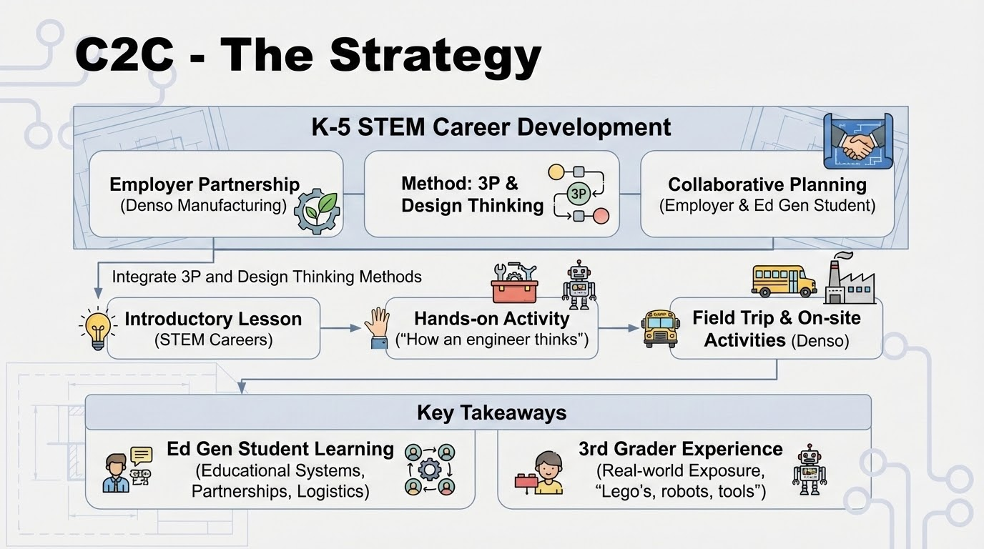

Slide 11
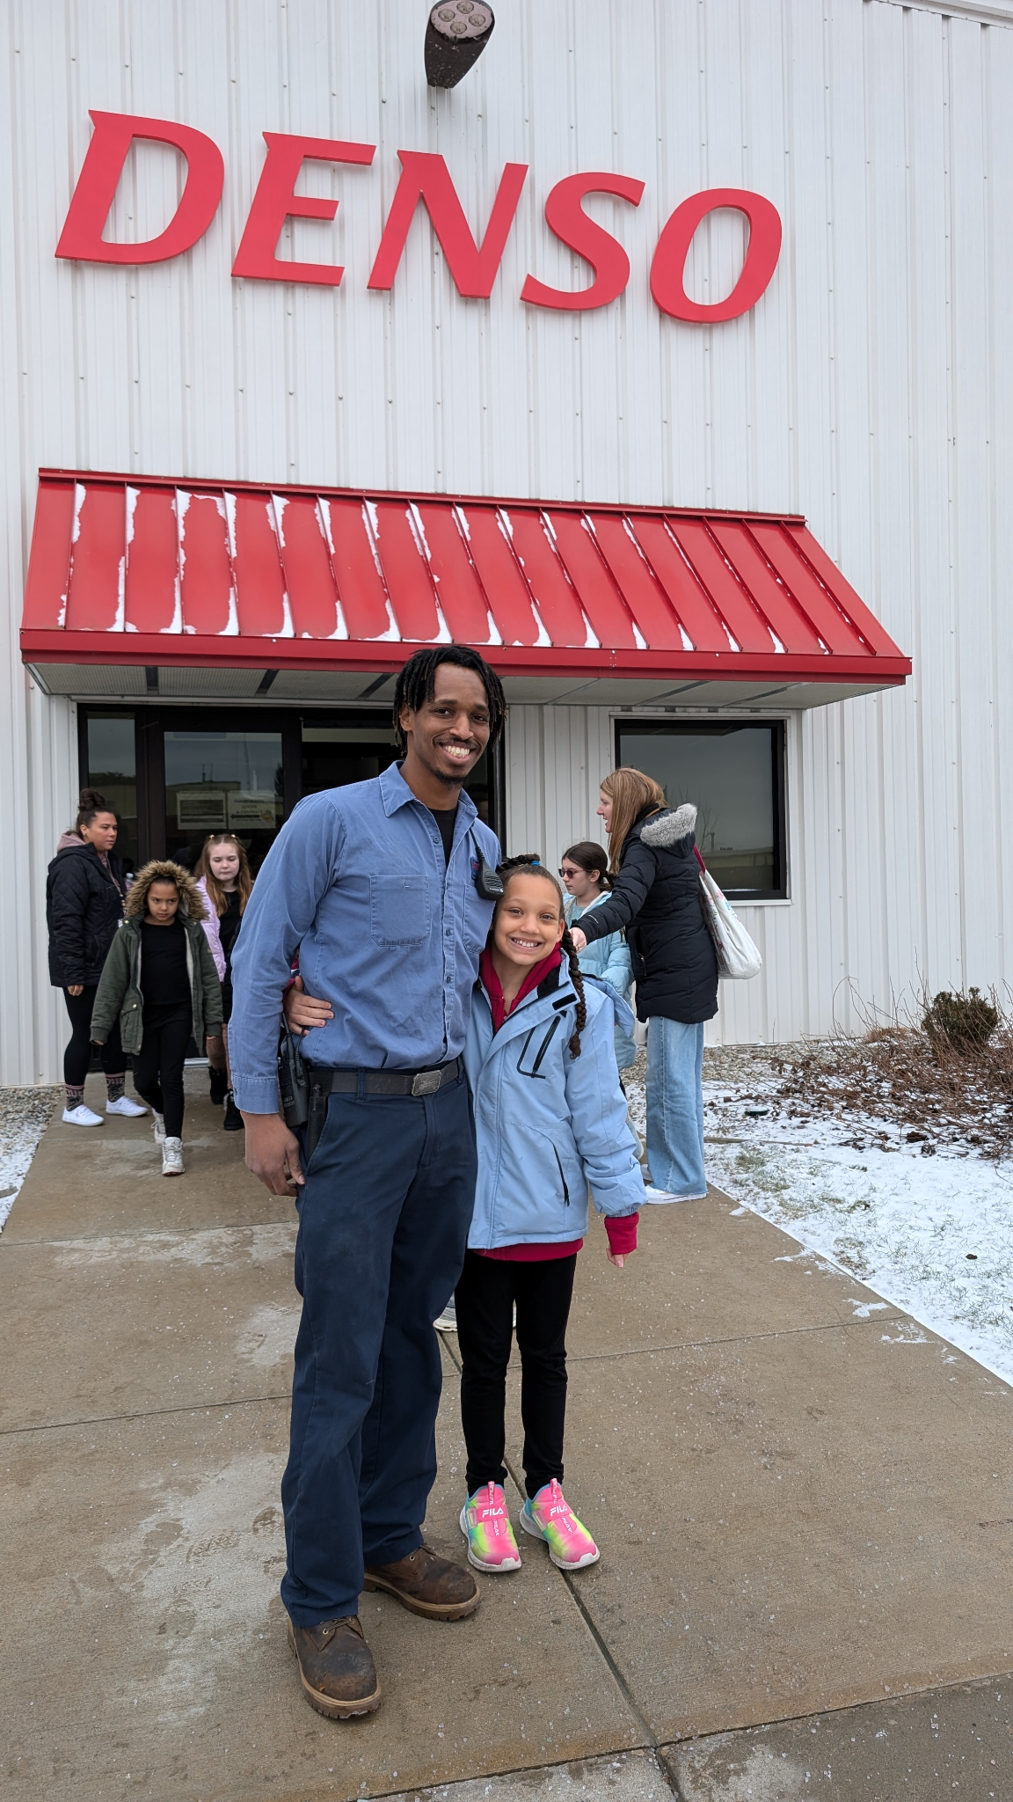
Crayons to Careers
Planting the seed of Career Development
The Goal: Connecting educators with employers to deliver high quality career development opportunities for students!
photos: https://photos.app.goo.gl/SVNB4sGBdDnaY6WQA

Slide 12
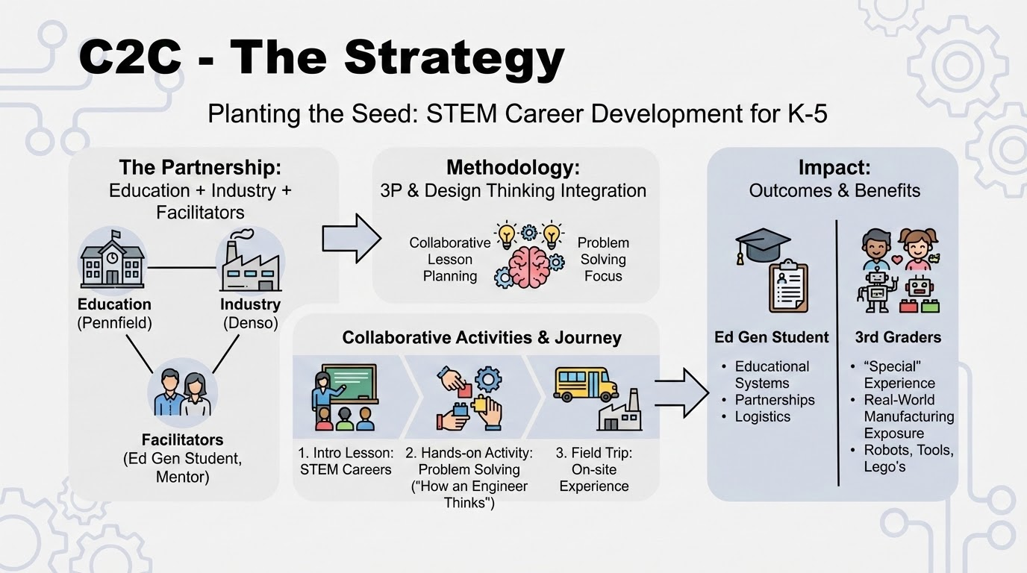

Slide 13
In the News
STEM students showcase school projects to lawmakers at Michigan's Capitol

Slide 14
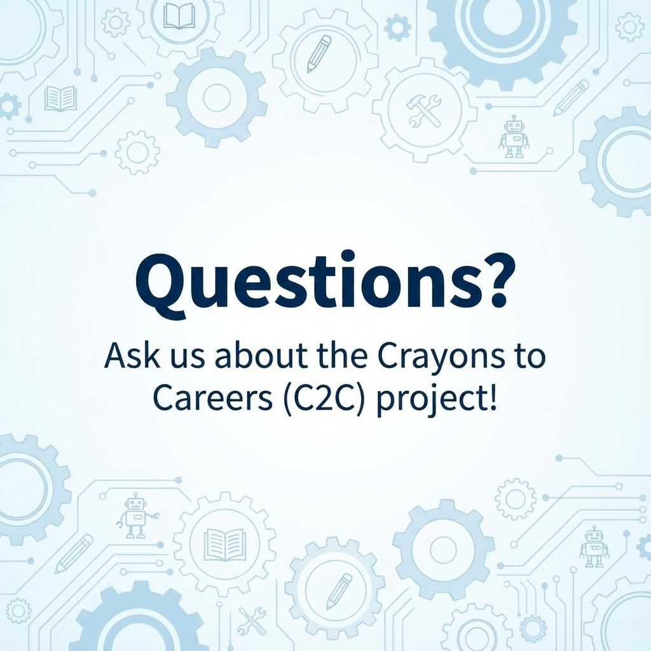

Slide 15
Ella’s Story
Ella’s Story: Chef

Slide 17
